Slide 1


Slide 2
High-Endurance microSDHC/XC Memory Card
Vertical Market Service Business Unit
March 2017

Slide 3
Agenda
Application, Features and Specifications
Appendix

Slide 4

Why Industrial Card?
Specification | Industrial Grade | Consumer Grade
Nand Flash | SLC/MLC | TLC
Endurance/ PE Cycle | 60K/3K | <300
BOM Control/PCN | YES | NO-built with whatever available
Reliability | High | Low
Longevity | Years by offering fixed BOM(P/N) | Constant solution Change
Extended temp | Standard: -25~+85 Extended:-40~+85 | 0~70
SMART | Yes | No
FA support | Yes | No
MTBF | >3Million | N/A

Slide 5
Agenda
Market Trend and Needs
Application, Features and Specifications
Appendix

Slide 6


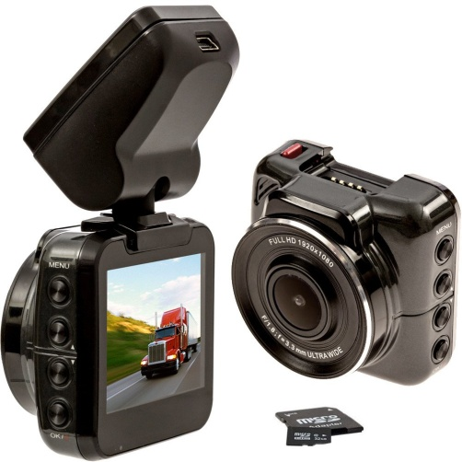




Applications
Storage in DVR
Control / monitor system
Video capturing device
In-Vehicle System
Server for IOT
Server
Suitable for Digital Signage, Transportation, Medical, POS, Surveillance, Video solution

Slide 7


Features
High-endurance
High-reliability Assurance
Provide up to 20,000hrs of Full HD video recording(128GB)
Store 32 hours of video footage with automatic write-over (128GB)
8-128GB with CL10 writing reach the speed to shoot FHD (1080P)
Improved speed
Enhanced Access Performance
Feature Ultra High Speed Class 3 (U3) specification
Maximum read/write speed of 75/65MB per second
Support ECC to increase data accuracy and integrity.
*DVR recording in“30Fps full HD”= FHD 1920x1080 = 1080p mode normally requiring write speed of SD\microSD card reaches 25Mb/s （megabit per second ）
( this requirement may vary from different DVRs, due to they have their own compression techs and different functions\modes\features; generally microSD are applied on Car DVRs( car recorders ) and most of them take less than 25Mb/s )

Slide 8
microSDXC H1-M Spec.
Interface | SD/SPI mode
Capacity | 128GB
BCH ECC (per 1K byte) | 42bit
NAND Support | To 15 MLC
R/W (MB/sec) | 75/65
Random 4KB Read (IOPS) Random 4KB Write (IOPS) | 1653/44
Wide Temp | -40℃ ~ 85℃

Slide 9
Agenda
Market Trend and Needs
Application, Features and Specifications
Appendix

Slide 10
128G microSD Lifespan in DVR
Car DVR Recording Mode | File size of General DVR's ( vary from DVR developers' compress tech & feature factors ) | 128GB microSD allows (hours) before starting loop recording. | 128GB microSD endurance Lifespan allows ( hours/days ) of recording.
1080p (1920 x 1080 ), 30 fps | 3~4 GB/hour | 32 | 20000 hours / 830 days
720p Dual (1280x1440), 30 fps | 2.6~3.6 GB/hour | 35 | 22000 hours / 920 days
720p (1280 x 720 ), 30 fps | 1.3~1.8 GB/hour | 71 | 44000 hours / 1840 days
WVGA ( 848 x 480 ), 30 fps | 0.6~0.8 GB/hour | 160 | 96000 hours / 4000 days
*based on the actual test results with Garmin GDR35 1080p & ASUS CR35

Slide 11


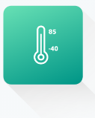


Value-Added Advantages
S.M.A.R.T. support
Write Protect
Wide Temperature
Content Pre-load
Erase
Advanced Wear Leveling algorithm and built in ECC to guarantee data integrity
Low power consumption
Auto read refresh
Operate under extreme environment
wide temp:-40~+85
passed shock & Vibration (x,y,z axis) test
waterproof/dustproof/X-ray proof

Slide 12


